Slide 1
GLASGOW CITY HEALTH AND SOCIAL CARE PARTNERSHIP
Occupational Therapy Services
Activities to try at home
www.glasgowcity.hscp.scot
OFFICIAL

Slide 2
Topics
Essential Self Care
4
5
6
7
9
11
12
15
16
Domestic Tasks
Outdoor Activities
Indoor Activities
Wellbeing
Exercises
Sensory Activities
Managing Behaviour
Posture and Seating
2
OFFICIAL

Slide 3
Essential Self Care
Wash your hands regularly
Have a shower
daily
Visit https://bit.ly/2JOb0xD for a guide to washing hands.
Add variety by choosing different sponges/scrubs and soaps
Brush your teeth twice a day
Treat yourself to foot spas, paint your nails & try new hairstyles
Download the Brush DJ app in app store for more fun
Have a daily massage
Ladies practice your make up sessions
Add variety to daily baths by adding scents.
OFFICIAL

Slide 4
Domestic Tasks
Add some of the activities below to your daily routine
Break up tasks into easy and hard, try and not do too many new things!! Make it fun, ask for help! Do it with a carer/family.
EASY
HARD (Will require help, an adult to show you - or just YouTube it!)
Hoovering large spaces
Dusting easy -reach spaces
Mopping floors
Organising drawers- add your own labels
Emptying bins
Writing a shopping list
Laundry- putting things in washer, hanging things up to dry, putting away in the drawer
Wiping down tables after meal times
Setting the table
Making a cup of tea
Using different brushes for narrower space
Dusting places out of reach- ask for help!
Preparing to mop the floor can require managing different amounts of cleaning liquid
Organising household items
Putting bin liners can require complex motor skills
Ordering shopping online
Laundry- folding and sorting
Changing bed sheets
Cleaning kitchen counters
Mending things
Polishing shoes
Making a tea with a teapot for the family out in the garden
Washing windows
Home decorating
OFFICIAL

Slide 5
Outdoor Activities
Potting plants
Weeding
Sitting in swing chair
Ball or racket games
Looking after bird table or feeder
BBQ
Touching and smelling plants and herbs and flowers
Frisbee
MAKE YOUR OWN BIRD FEEDER
CBeebies: https://www.bbc.co.uk/cbeebies/makes/bird-feeder
YouTube: https://www.youtube.com/watch?v=7yV6V6rtpyc
OFFICIAL

Slide 6
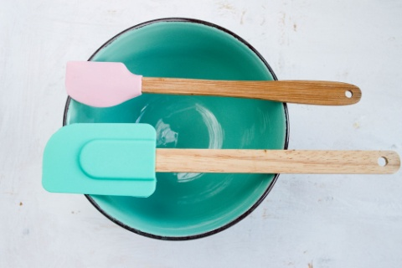
Indoor Activities
Coloring, art and craft, photobooks, reading
Movies, music, podcasts, audiobooks, games, dancing
Watch Jamie Oliver
Baking, cooking try a new recipe
www.jamieoliver.com
Meditation and Relaxation
OFFICIAL

Slide 7
Getting Bored? Try these fun activities
Play keep up the balloon Focus on stretching and big movements
Tie dye or paint T-shirts. You can event print a design for these and have someone iron it on.
Make a life story about yourself. Or maybe a mood board of all the things you like!
Decorate the garden with chalk
01
03
05
07
Have a go at Yoga or a dance routine on YouTube
Make jewellery (string and beads) if this is safe to do so
Play musical games i.e. musical statues/musical chairs
Make giant bubbles outside
02
04
06
08
Make paper airplanes and boats. Race these. Use descriptive words to talk about what is happening. Try new designs and techniques i.e. fast or slow.
Do a virtual tour online You could visit a zoo or a museum! https://bit.ly/3bTN5ZS
09
10
OFFICIAL

Slide 8
Wellbeing
Stay in Contact with Friends & Family
WhatsApp video calls
Facetime (only available on apple devices)
Facebook video calls
Facebook
Instagram
Snapchat
Skype
Zoom
Emails and recordings
Cards and letters
MIND website
National Autistic Society has created a MIND website with resources to stay safe at home
Visit: https://bit.ly/2xaz5Mq
STAY SAFE WHILE ON SOCIAL MEDIA
Easy read material
STAY SAFE WHILE USING SOCIAL MEDIA
https://www.changepeople.org/Change/media/Change-Media-Library/Blog%20Media/Keeping-Safe-Online-Easy-Read-Guide-Small-File-Size.pdf
OFFICIAL

Slide 9
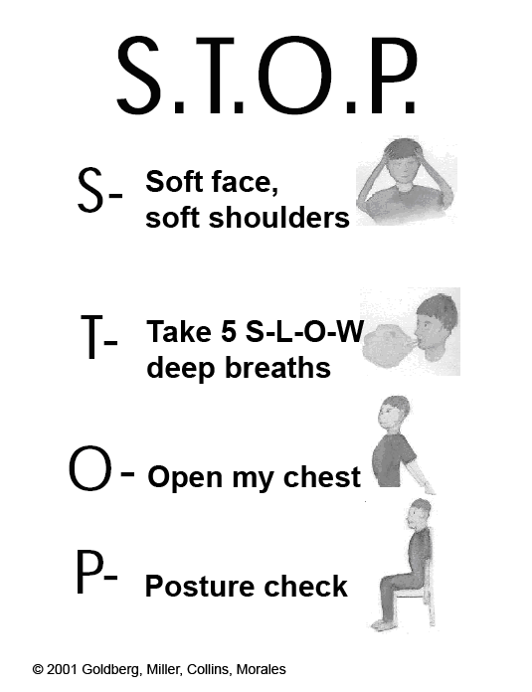
Easy Relaxation
OFFICIAL

Slide 10
Exercise
Joe Wicks “The Body Coach”
9am P.E sessions - https://bit.ly/3bW52a9
Go Noodle
Here’s a collection of exercises you can do while staying at home or in your garden.
Keep exercising - https://bit.ly/34cYnpz
Circuits in the garden
Dog walking
Muddy walks
OFFICIAL

Slide 11
Sensory Activities
PRODUCTIVE TASKS AT HOME
PROPRIOCEPTION
Loading / unloading washing machine
Wiping counters
Carrying shopping
Carrying boxes / items
Washing windows
Vacuuming
Mopping
Sweeping
Taking out rubbish / recycling
Digging
Weeding
Watering plants using watering can
Going up and down stairs to fetch items
Mixing cake with spoon
Kneading, and rolling dough
ORAL MOTOR
Wall push ups
Chair or desk push ups
Stretchy bands on chair for feet
Body sock
Increase movement by doing small jobs
Wiping counters/ tables / windows
Squeeze toy / fiddle
Have crunchy or chewy food at breakfast and throughout day
Use drinks bottle with valve
Moving furniture
Going up and down stairs
Follow SLT guidelines if there are any dysphagia concerns
Blowing bubbles
Sucking thick liquids milkshake /
Smoothie through a straw
Chewing - gum, bagels. dried fruit
Eating crunchy food / ice
Sucking sweets
Using curly straw
Drinking from sports bottle
OFFICIAL

Slide 12
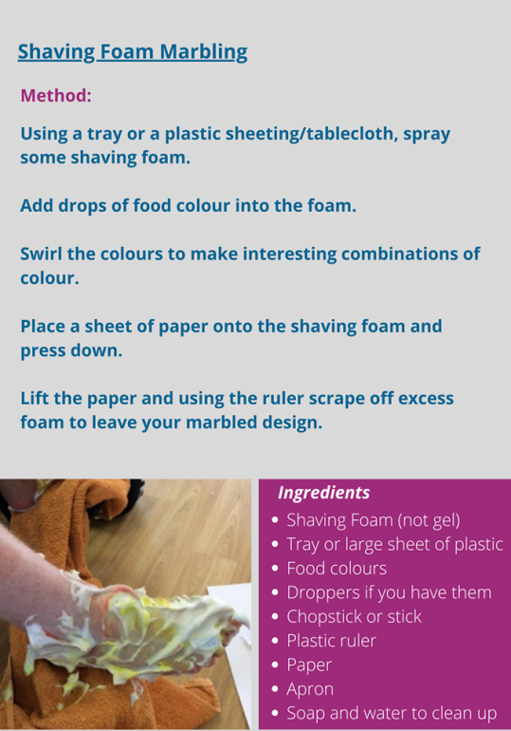
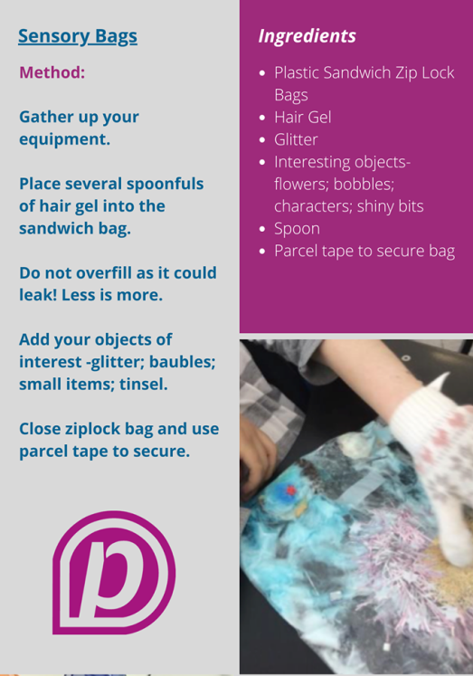
Easy activities to try at home
OFFICIAL

Slide 13
Something more on Sensory
National Autistic Society has more information on our senses
https://www.autism.org.uk/about/behaviour/sensory-world.aspx
Useful Links
Sensory issues and handwashing
Handwashing is crucial in reducing risk of Covid-19. Please see advice from Sensory Integration about this https://www.sensoryintegration.org.uk/News/8821506
OFFICIAL

Slide 14
Managing Behaviour
At this time of unprecedented change the person you support may appear to behave in an unusual manner particularly individuals with Autism. There is usually a reason for this behaviour, it can be due to the individual being unable to understand the situation e.g. why a routine has changed; or ways of coping. Knowing what causes behavioural difficulties can help you to think of and devise ways of dealing with the behaviour
It may be helpful to use the iceberg analogy (below) when assessing the situation
USEFUL LINKS
National Autistic Society https://www.autism.org.uk/about/behaviour/challenging-behaviour.aspx
Person plan for change https://www.autism.org.uk/about/behaviour/preparing-for-change.aspx
Positive behaviour support principles for practice for COVID-19 https://www.bild.org.uk/wp-content/uploads/2020/04/PBS_principles__for_practice_COVID-19_Final_draft-00000002.pdf
OFFICIAL

Slide 15
Posture and Seating
Keeping active where possible , aiming to change position as frequently as you can.
Positions include
Rolling
Side-lying
Sitting
Using a standing frame
Moving in your chair
Continue any physiotherapy programs you have been provided with.
Bobath scotland (https://cerebralpalsyscotland.org.uk/coronavirus-covid-19-and-cerebral-palsy/ has useful information on
-Keeping active
-Looking after your equipment
-Hand washing
More resources:
Yoga for wheelchair users
https://kdsmartchair.com/blogs/news/58783043-yoga-for-wheelchair-users-8-poses
Activities for wheelchair users
https://www.specialneeds.com/activities/mobility-limitation/activities-kids-exercises-children-wheelchairs
OFFICIAL

Slide 16
References
PAMIS
http://pamis.org.uk/
Are an organisation that works and supports People with Profound and Multiple Learning Disabilities (PMLD) and their families.
NATIONAL AUTISTIC SOCIETY https://www.autism.org.uk/
Is the leading UK’s charity for Autistic people. Their website provides information and advice for Autistic people, friends and families across the UK including training courses, also support for Professionals.
DOWNS SYNDROME ASSOCIATION https://www.downs-syndrome.org.uk/
The Down ’s syndrome Association (DSA) is the only charity in the UK dealing with all aspects of Down’s syndrome. Its aim is to help people who have Down’s syndrome live full and rewarding lives. Their website provides information and advice for families, carers, people with Downs Syndrome, new parents, and professionals.
MENCAP
https://www.mencap.org.uk
Is a UK learning disability charity working with people with learning disabilities and their families and carers. Their website provides information on everyday living, friendships and relationships, early years and children, health and wellbeing, also services to support people helping independently for the first time.
OFFICIAL

Slide 17
Thank you
Staying safe and keeping healthy during the outbreak of COVID-19 will help protect yourself and others.
OFFICIAL

